Slide 1

Introduction to Programming and Problem Solving
Behram Khan

Slide 2
Course Learning Outcomes
Understanding of Programming Concepts Students will be able to explain what programming is and describe the role of programs and instructions in computer operations.
Problem-Solving Skills
Students will demonstrate the ability to analyze problems, break them down into manageable parts, and devise effective solutions using systematic problem-solving techniques.
Basic Algorithm Design
Students will be able to create simple algorithms and represent them using pseudocode and flowcharts, illustrating their understanding of logical sequencing and decision-making in programming.
Familiarity with Computer Architecture
Students will gain a foundational understanding of basic computer architecture concepts, including the roles of the CPU, memory, and input/output devices in executing programs.
Knowledge of Data Storage and Memory
Students will be able to explain the concepts of primary and secondary storage, including the differences between RAM, registers, and long-term data storage.

Slide 3
Course Learning Outcomes
Introduction to a Programming Language
Students will be able to write, test, and debug simple programs in a high-level programming language to solve basic problems and perform calculations.
Application of Programming Principles
Students will apply programming principles to automate simple tasks and create practical solutions, demonstrating an understanding of how programming can enhance efficiency in various applications.
Collaboration and Communication Skills
Students will develop skills for working collaboratively in teams, communicating ideas effectively, and sharing solutions to programming problems.
Critical Thinking and Analytical Skills
Students will enhance their critical thinking and analytical skills by evaluating different approaches to problem-solving and recognizing the trade-offs involved in various programming strategies.

Slide 4
Grading Policy
Sessional: 30%
Mid Term: 20%
Final Term: 50%

Slide 5
Class Attendance
Students must ensure a minimum of 75% attendance. They will be marked absent if they arrive more than 15 minutes late to class.

Slide 6
Lecture Overview
In this first lecture we will cover the fundamental theoretical concepts that form the backbone of modern computer systems.
This session focuses solely on theory, providing a solid foundation for understanding computers and programming
Involving examples and interactive session to develop problem solving

Slide 7
Learning Objectives
By the end of this lecture, students will be able to:
Define and explain what is programming
Develop a thought process of solving a problem
Understand the architecture of computer

Slide 8
What is a Program?

Slide 9
What is a Program?
Program : Set of instructions which tell computer how to solve a specific task or problem.
Calculator program
2+2
What are instructions?
Instructions are specific commands or statements within a program that tell the computer to perform a particular action.

Slide 10
Scenario
Scenario -> I want to write some information to read later
How will I do this on a computer?

Slide 11
Scenario
1 Manually making a text file
2 Using CMD to make a text file
type nul > textfilename.txt
To make file with initial text
echo Hello World! > myfile.txt

Slide 12
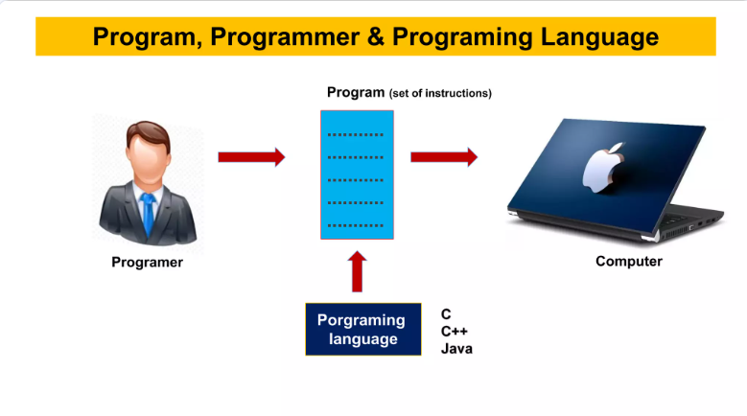
What is Programming?
Programming : Programming is the process of creating programs

Slide 13
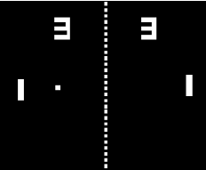


Why we need programming?
Ease of tasks
Easypaisa
Problem Solving
Life very boring
Make a game

Slide 14
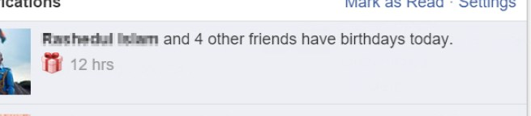
Why we need programming?
Automation
Robots in industries
Birthday reminders

Slide 15
Job Opportunities
Programmers are in high demand in nearly every industry
across the globe
The average salary for a software engineer in the United States
is around $12,293 per month = 3,413,151.45 Pakistani Rupee

Slide 16
Computer Is just a dumb piece of silicon which we refined into a processor and programming gives it life. -Behram Khan

Slide 17
How to make a program?

Slide 18
How to make a program?
Programming is another name for problem solving.
The process of finding a solution to an issue and making a programming (app/software) solution for it.

Slide 19
Steps in problem solving
Understand the Problem: Read the problem carefully, make sure you know what’s being asked.
Plan the Solution: Break the problem down into smaller steps. Use a flowchart or pseudo code (plain English) or algorithm to outline the steps.
Write the Code: Turn your plan into a program using a programming language like C++/python etc.
Test and Debug: Run the program to check if it works correctly. If not, fix the issues in it.

Slide 20
Problem: Creating a Simple Cricket Game
Scenario: You want to create a simple cricket game where a bowler bowls the ball, a batter tries to hit it, and fielders are positioned to catch or stop the ball.

Slide 21
Understanding the Problem
Goal: Create a basic cricket game without anything complex

Slide 22
Breaking Down the Problem
Subproblems:
Bowler: Represents the player who bowls the ball.
Batter: Represents the player who tries to hit the ball.
Batter can hit it
Batter can miss it
Fielders: Represents players positioned on the field to catch the ball.
Can stop the ball
Can catch it
Winning Condition: Batter hits 3 balls without missing or getting out.

Slide 23
Developing an (Plan)
Bowler bowls the ball.
Batter decides to hit or miss.
Check if the ball is hit:
If hit, determine if it’s caught or stopped by fielder
If missed, update the game status.
-1 from total balls remaining
Output the results of the actions taken on screen

Slide 24
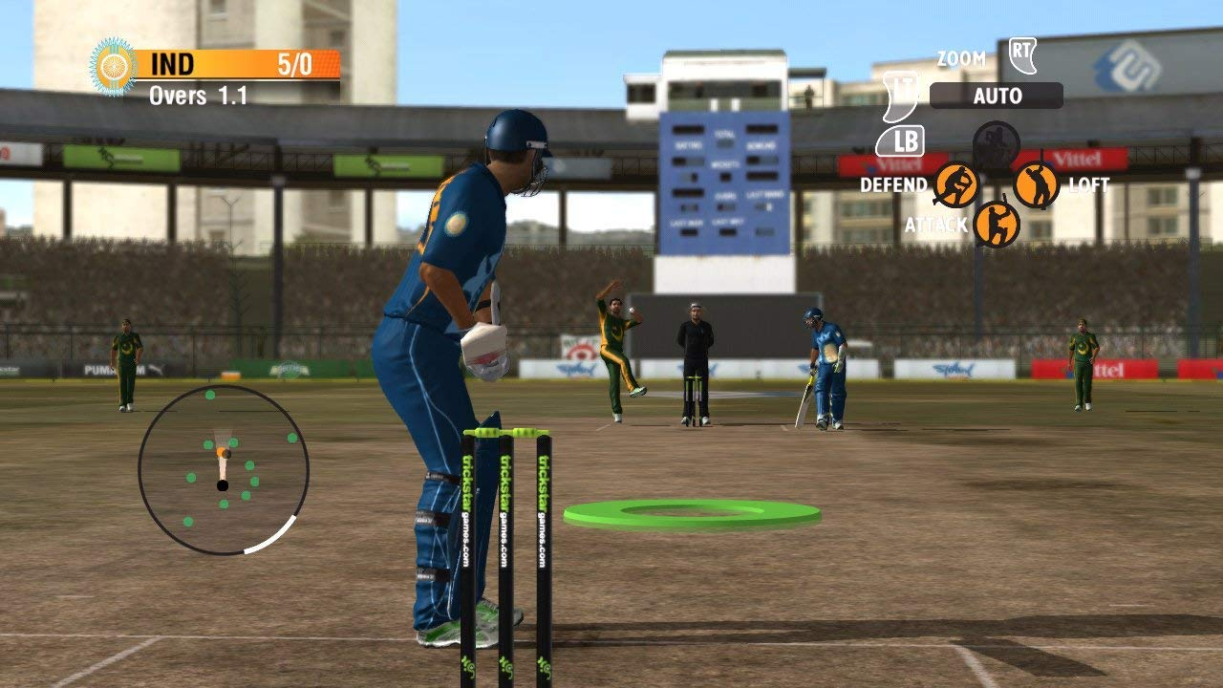
Write code
Convert Plan into code

Slide 25
Test and Debug
If we throw ball, and its going wrong direction -> Backward?
If we press hit and it doesn’t hit.
When we press catch and it doesn’t catch.
Fix these issue and test again until problems solved

Slide 26
Now that we have a solution to our problem, we need a platform to execute that solution A COMPUTER!

Slide 27
Computer Architecture

Slide 28
What is Architecture?
Provides a high-level description or blueprint of how a computer system is designed without focusing on the specific details of how things are physically implemented.
Tells us How a computer is made without going into details.
Task : 2x2
What computer parts do we need to get the output?

Slide 29

Von Newmann Architecture
John von Neumann was a mathematician and physicist by profession.
Oppenheimer Movie
He worked on Manhattan Project
Proposed architecture in 1945 after World War II
A way how a general-purpose computer should be made

Slide 30
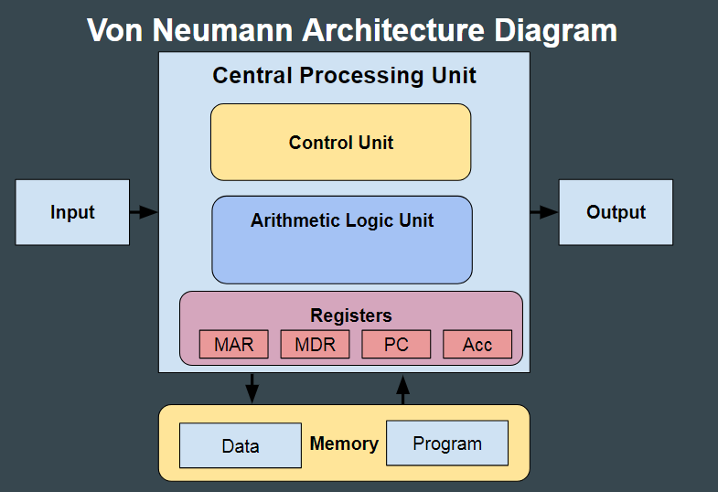
Von Newmann Architecture

Slide 31
Von Newmann Architecture
It is also known as ISA (Instruction set architecture) computer
This architecture has 3 main components
Central Processing Unit
Memory
Input/Output

Slide 32
Main Memory
Main memory stores instructions and data
Data? Instructions?
short-term memory of a computer (Volatile)
It helps the computer quickly access and work with data and programs while it's running. (Very Fast)
When we open an app or browser, its loaded in main memory. This way computer can quickly access instructions and data.
Similar to work desk

Slide 33
CPU
The central processing unit is defined as the it is an electric circuit used for the executing the instruction of computer program.
Brain of the Computer
It has following major components:
Control Unit(CU)
Arithmetic and Logic Unit(ALU)
Variety of Registers

Slide 34
Control Unit
Control units controls and coordinates the overall working of the computer system
It directs all input and output flow
fetches code from memory for instructions
controls how data moves around the system
handles all processor control signals.
Read about them yourself
Timing Signal
Control Signals

Slide 35
Arithmetic and Logic Unit (ALU)
The arithmetic logic unit is that part of the CPU that handles all the calculations the CPU may need.
It performs Logical Operations and Arithmetic operations.
Logical Operations
Ball caught or not? Did batter hit the ball or not? Yes/No answers
Arithmetic operations.
Addition, Subtraction, Comparisons.

Slide 36
Registers
Temporary storage place to store instruction, data or addresses
Very small in size usually of few bits ( What is a bit )
Why use it? Why on top of CPU?
CPU is faster in speed than Memory (RAM)
Speed faster than RAM , Closer to CPU
Access results, ongoing calculations faster.
To keep their speed matched.

Slide 37
Registers
Accumulator: Stores the results of calculations made by ALU. It holds the intermediate of arithmetic and logical operations. it acts as a temporary storage location or device.
Program Counter (PC): Keeps track of the memory location of the next instructions to be dealt with. The PC then passes this next address to the Memory Address Register (MAR).
Memory Address Register (MAR): It stores the memory locations of instructions that need to be fetched from memory or stored in memory.
Memory Data Register (MDR): It stores instructions fetched from memory or any data that is to be transferred to, and stored in, memory.

Slide 38
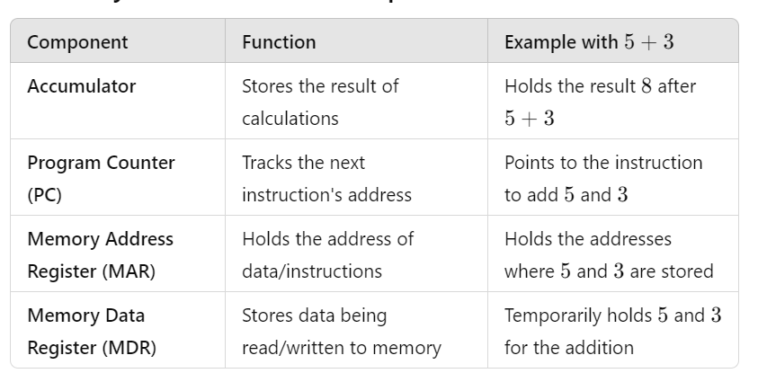
Registers

Slide 39
Registers
Learn about
CIR
IBR

Slide 40
Input/Output
We give commands/instructions from input device
Keyboard
mouse
Display the output on an output device
Monitor
Speaker

Slide 41
Buses
Data is transmitted from one part of a computer to another, connecting all major internal components to the CPU and memory, by the means of Buses. Types:
Data Bus: It carries data among the memory unit, the I/O devices, and the processor.
Address Bus: It carries the address of data (not the actual data) between memory and processor.
Control Bus: It carries control commands from the CPU (and status signals from other devices) in order to control and coordinate all the activities within the computer.

Slide 42
Q/A?
Recap:
Programming is about giving instructions to computers to solve problems.
Problem-solving in programming involves breaking tasks into steps.
The Von Neumann architecture is the fundamental model of how computers work.

